Slide 1

Educational Center of High-Tech Park (It-Academy) website
Test result presentation 24.05.2018 - 25.06.2018

Slide 2

The educational center of the High-Tech Park prepares highly qualified specialists able to work in a dynamically developing industry. Annually our center prepares more than 1000 specialists in such areas as software development, testing, design, business analysis. Our teachers have developed more than 127 training courses of different levels of training.

Slide 3
The IT Academy was opened in 2011, six years after the founding of the High-Tech Park. The center was created to meet the need for qualified personnel and since the release of the first specialists the center has gone a long way of development and development. Today they can be proud of the title of the best IT education center.

Slide 4
Group's device division
 | Tatiana | Anton | Nadia | Vlad
Devices | win 7, iphone 5c, ipad 2 | win 10, iphone 6+ ipad 4 | win 7, Tablet Samsung | win 10, Huawei GT3 (Android 7)
Browsers | Safari, IE 11 | Edge | Opera | Chrome

Slide 5


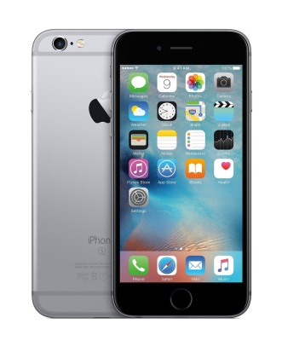
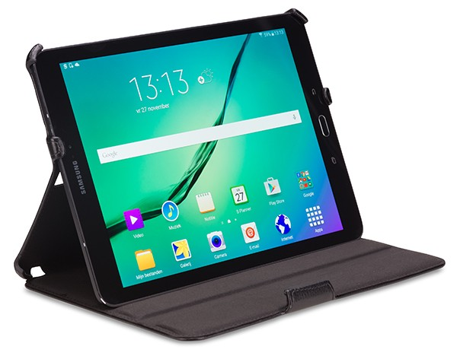
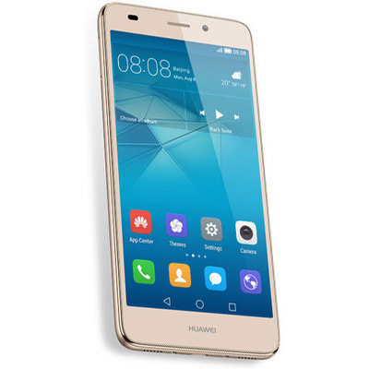
Configuration testing

Slide 6


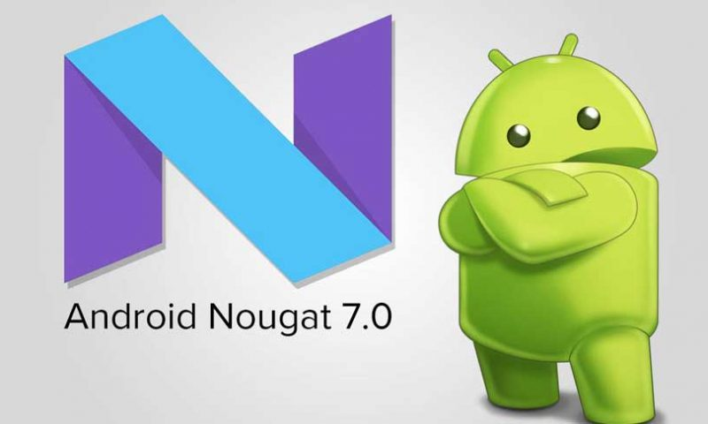

Compatibility testing

Slide 7
Other types
Usability testing
GUI testing
Responsive design testing

Slide 8





Cross-browser testing

Slide 9
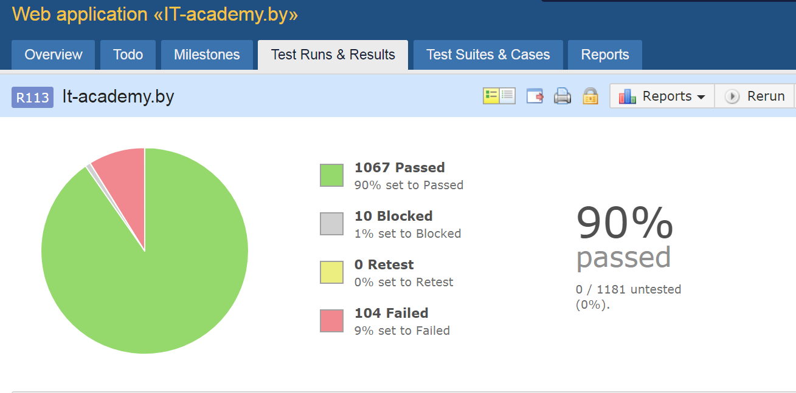

Slide 10
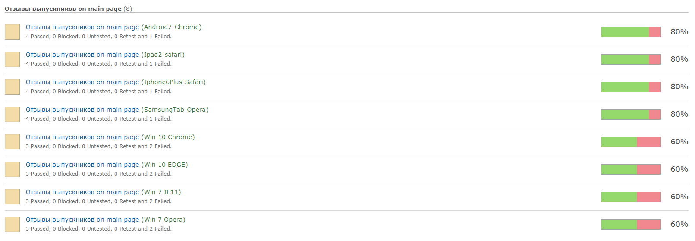

Slide 11
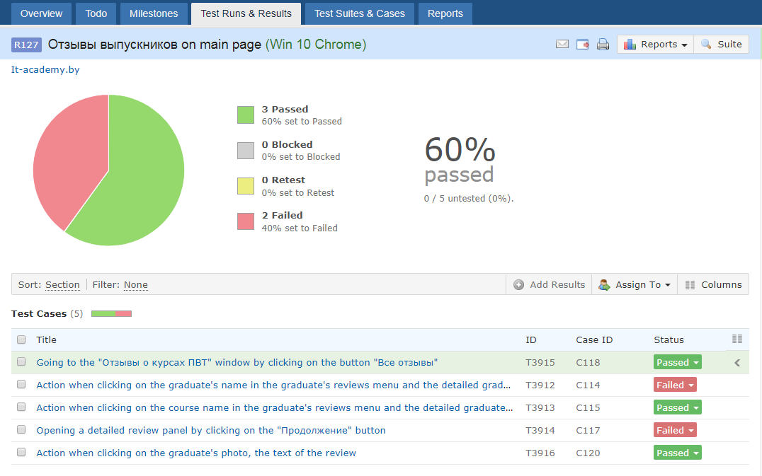

Slide 12
Bugs found
Status | Quantity | Severity
 |  | Blocker | Critical | Major | Minor | Trivial
Submitted | 22 | 0 | 0 | 2 | 18 | 2

Slide 13

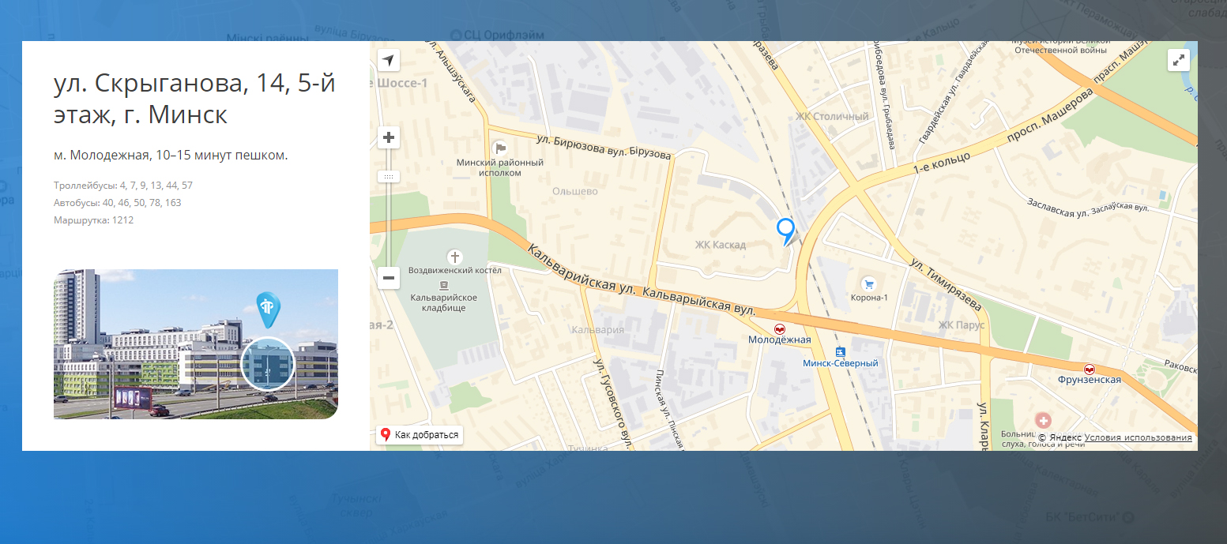

Slide 14
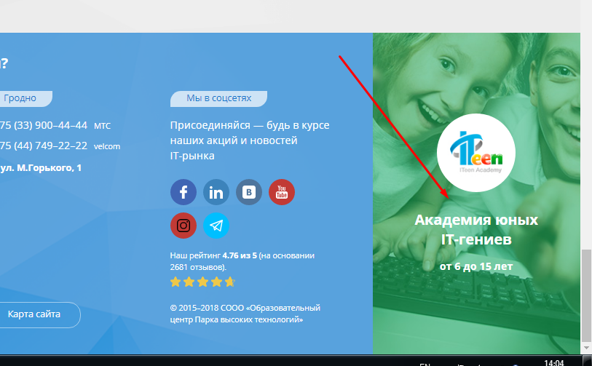
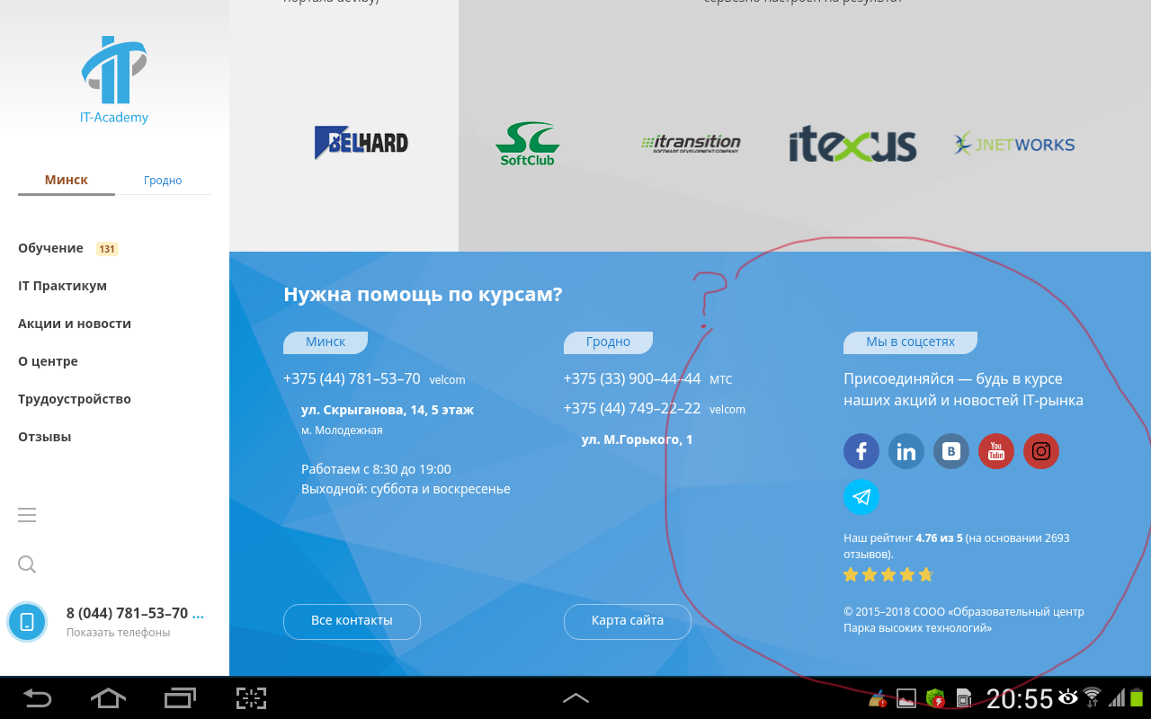

Slide 15
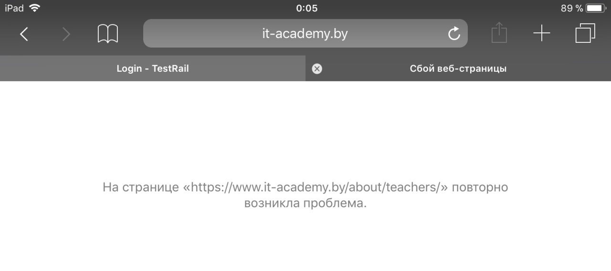
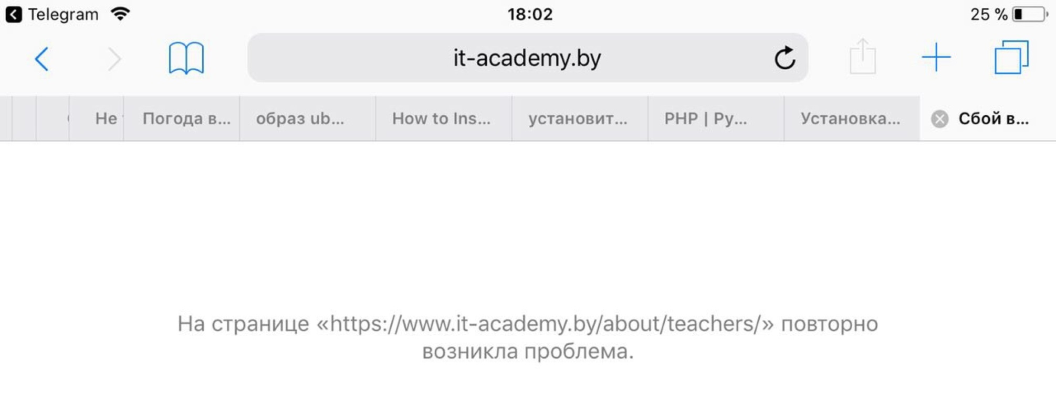

Slide 16
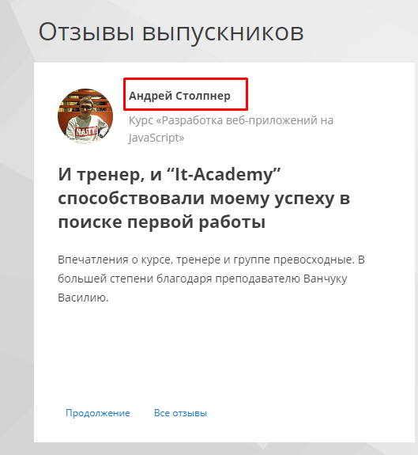
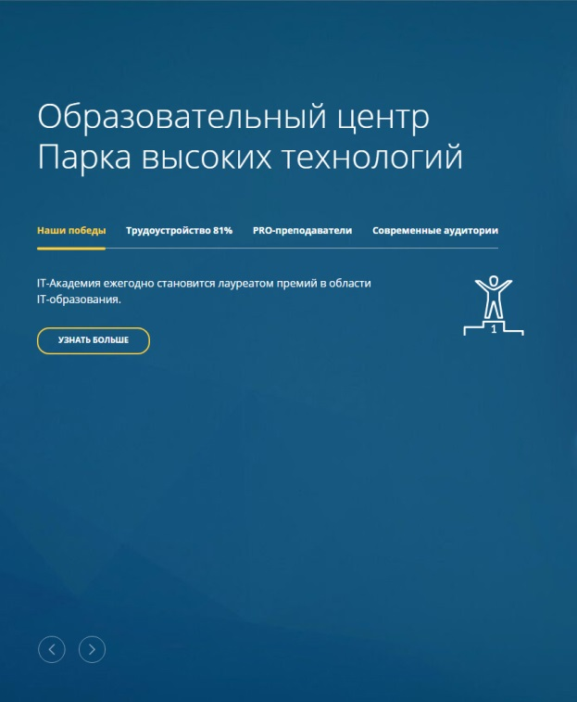

Slide 17
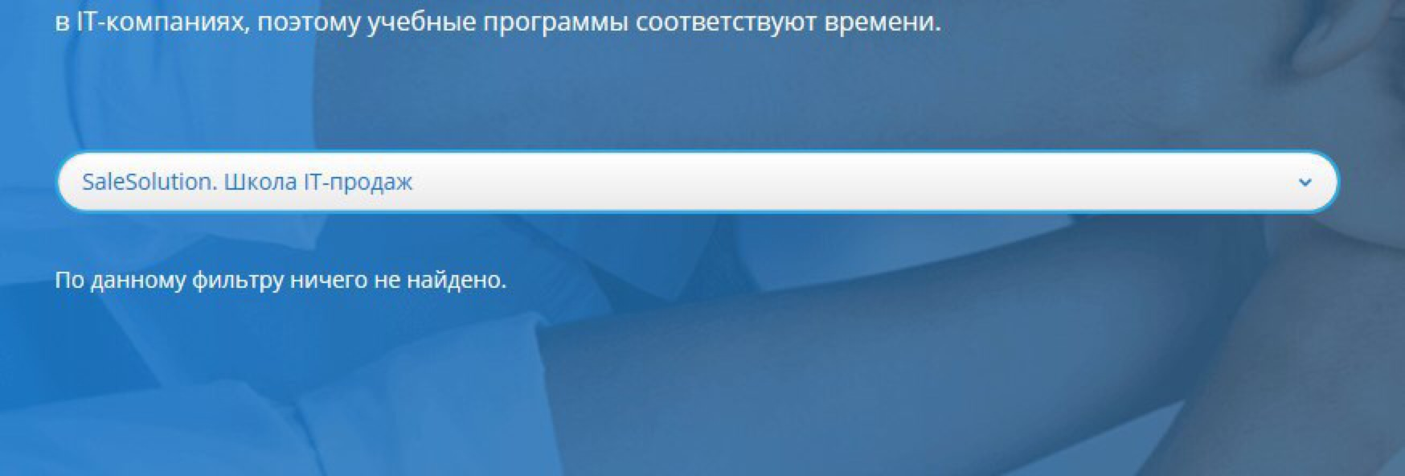
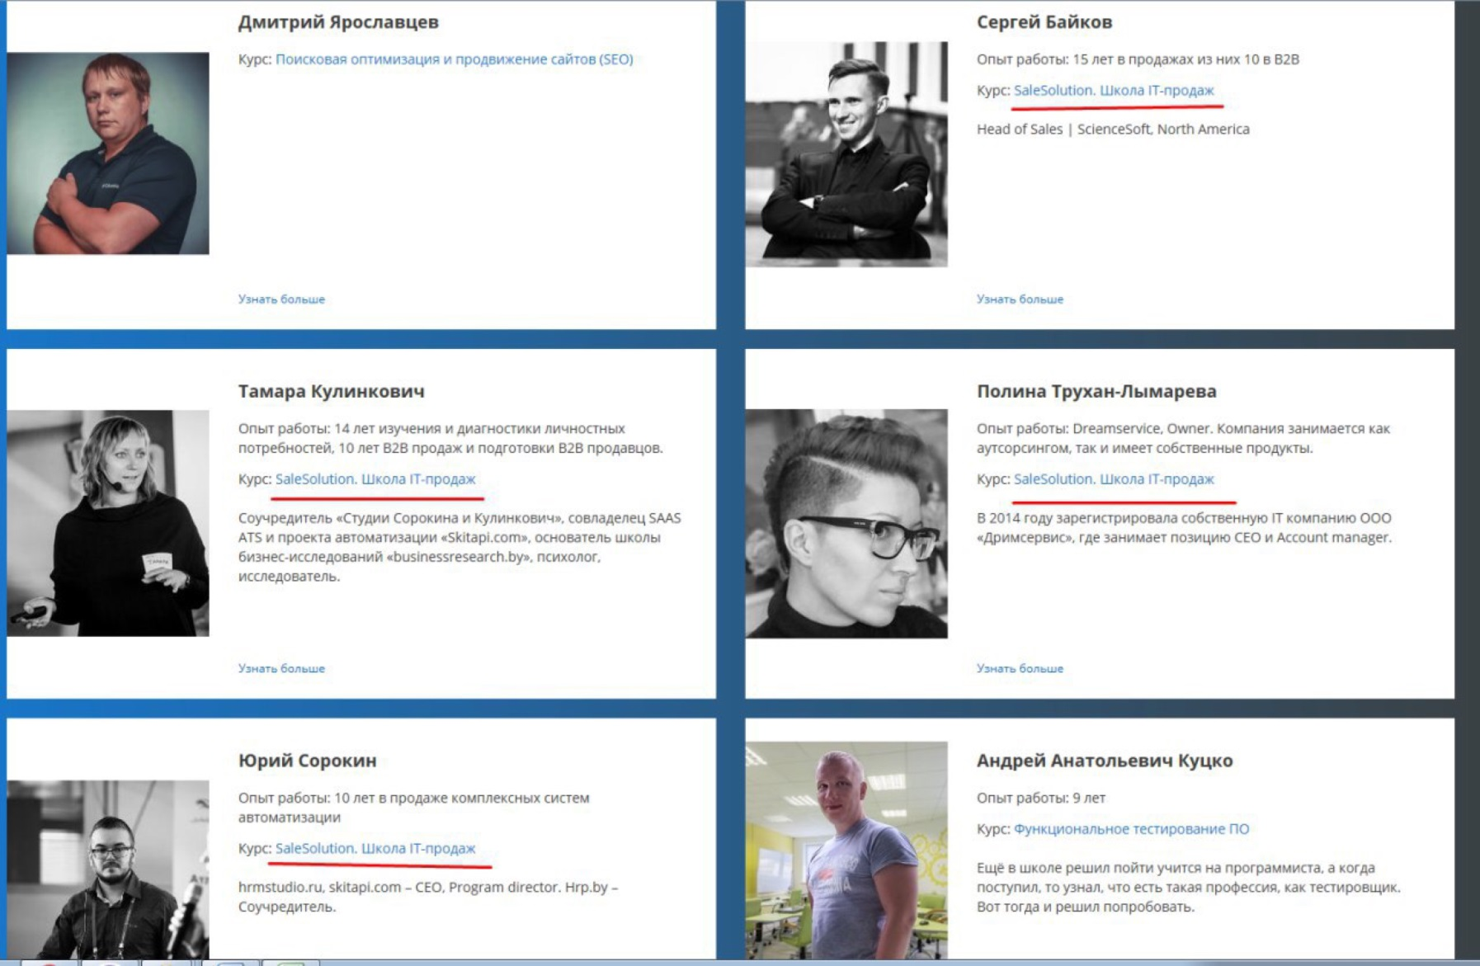

Slide 18
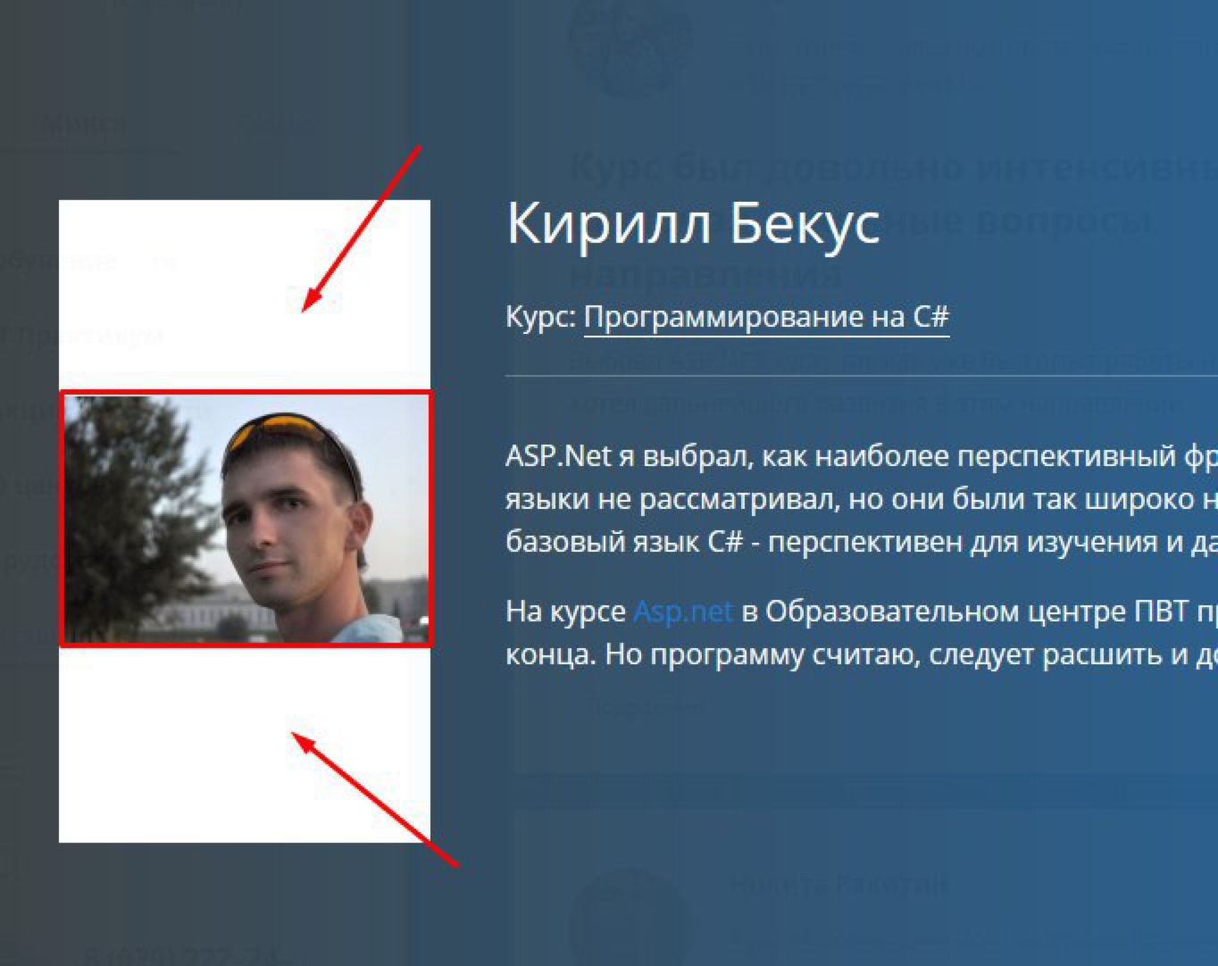
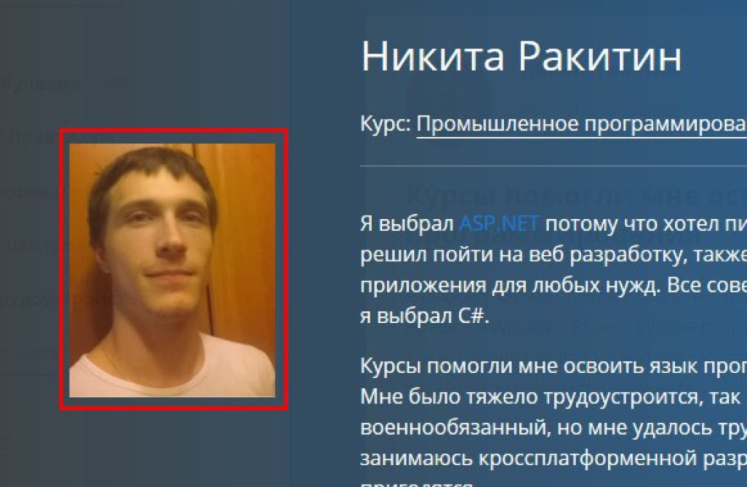

Slide 19
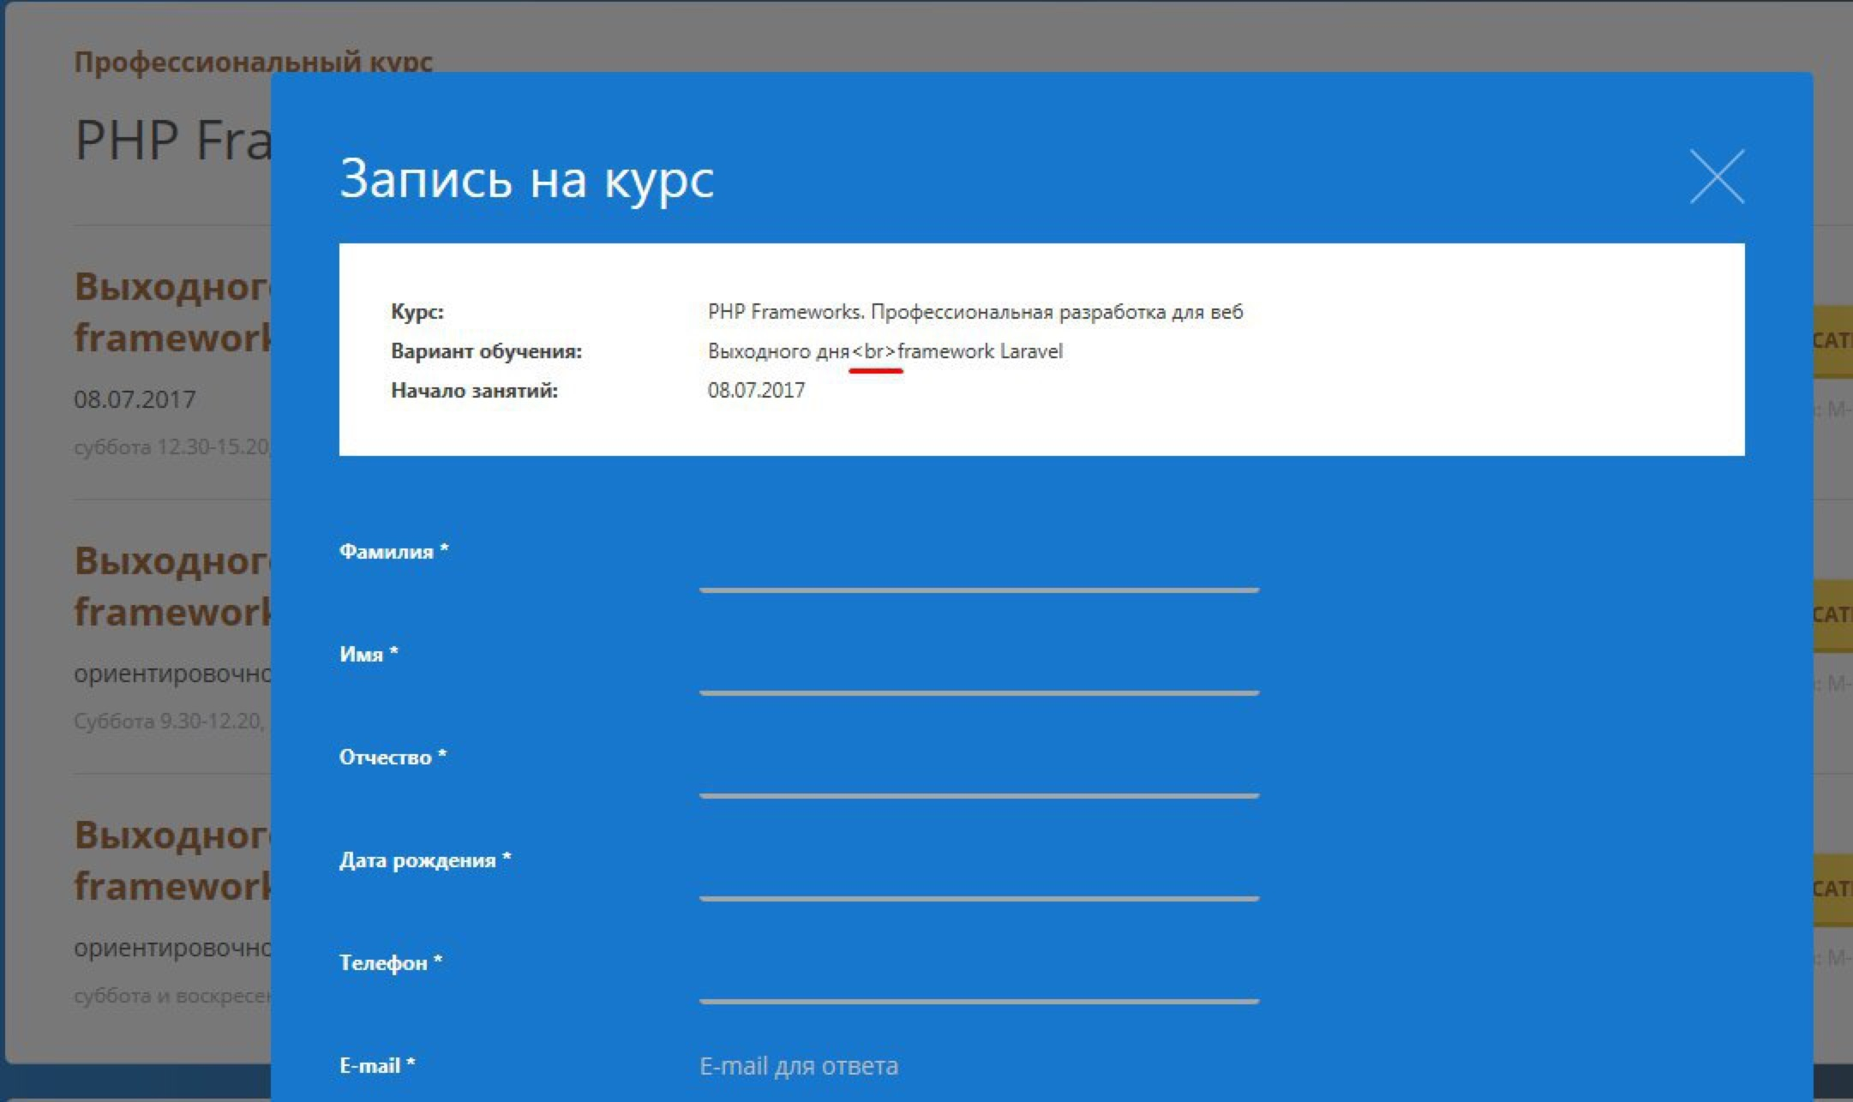

Slide 20
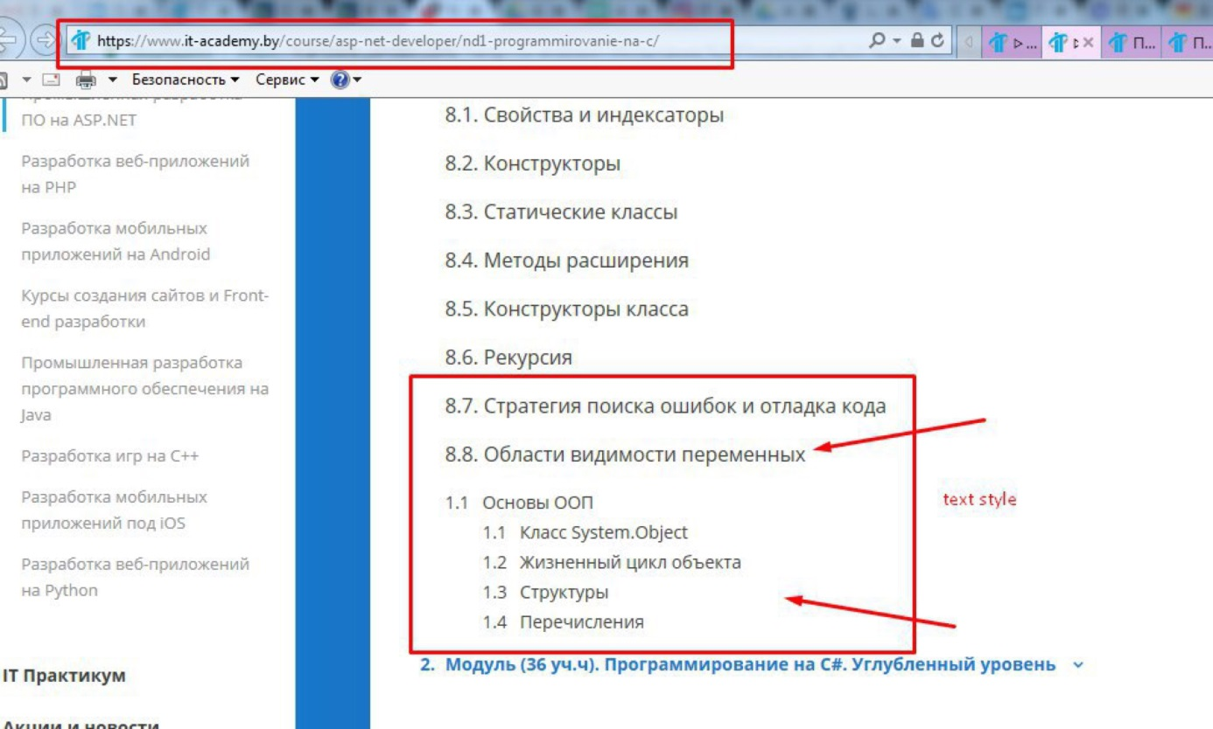
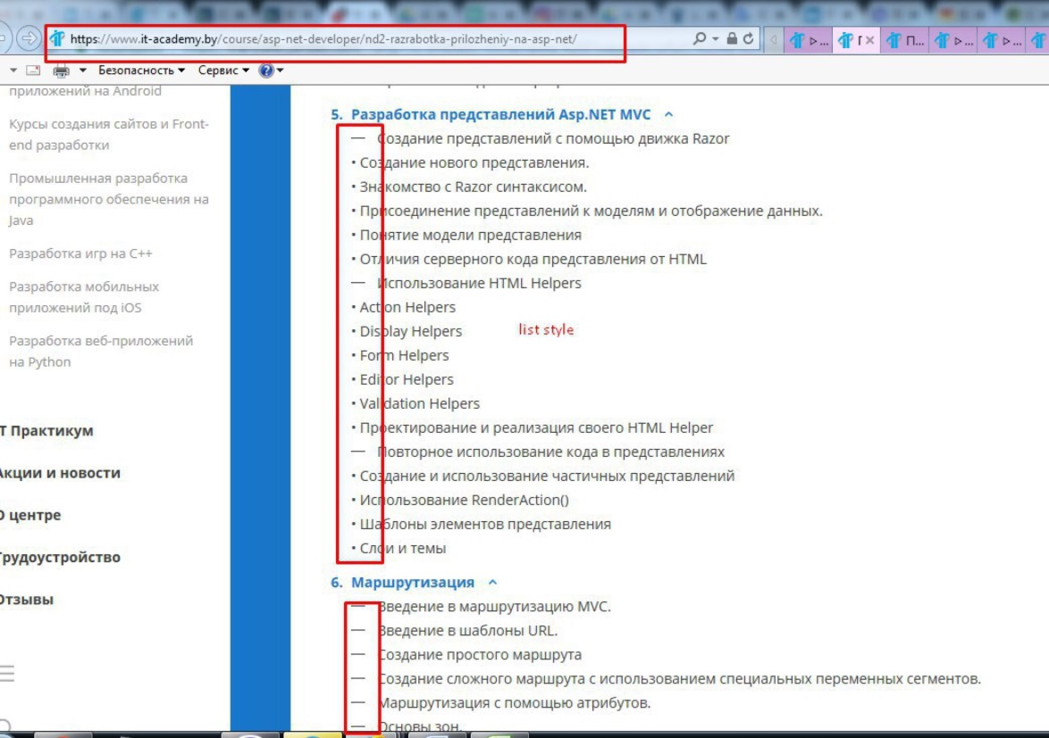

Slide 21
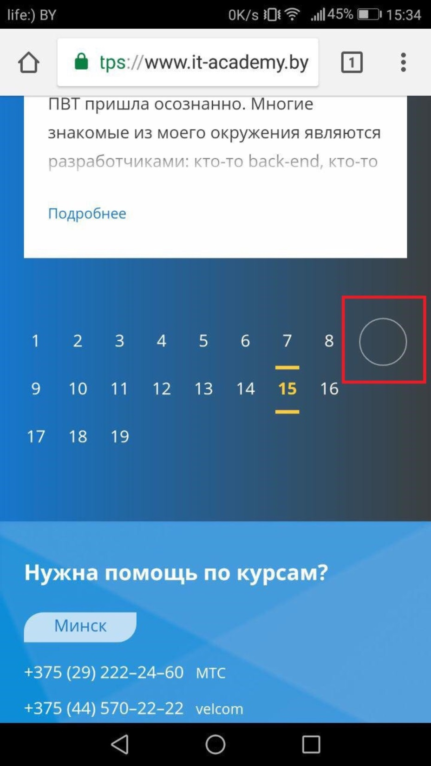

Slide 22
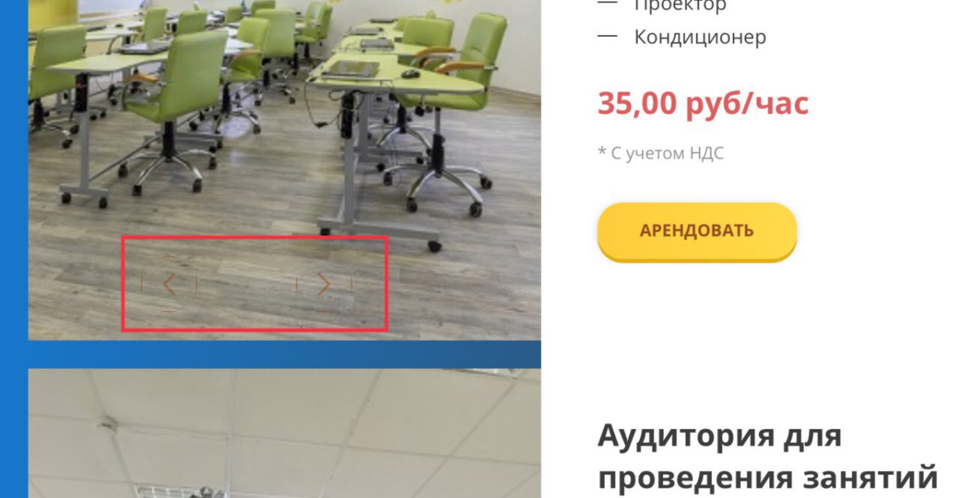
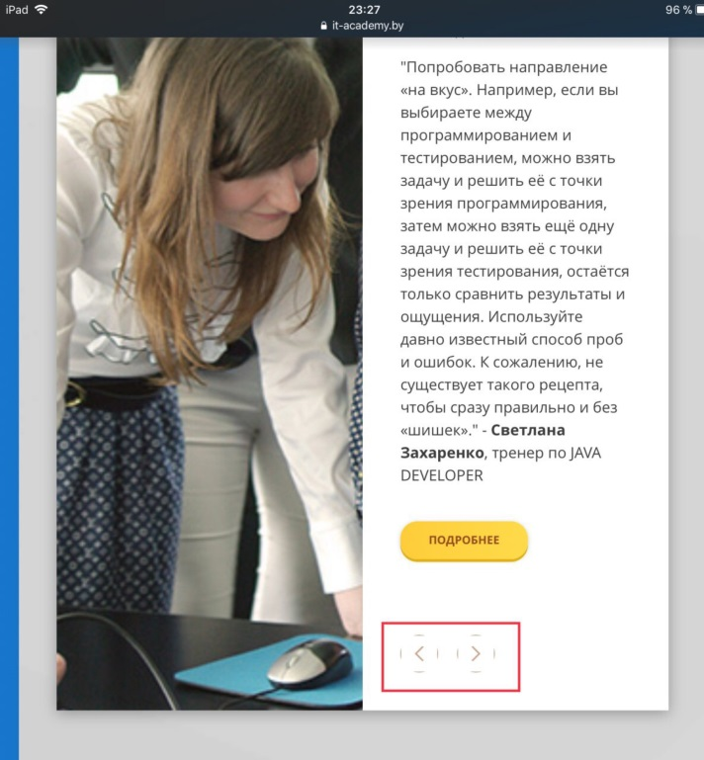


Slide 23
Thank you for attention!

